Slide 2
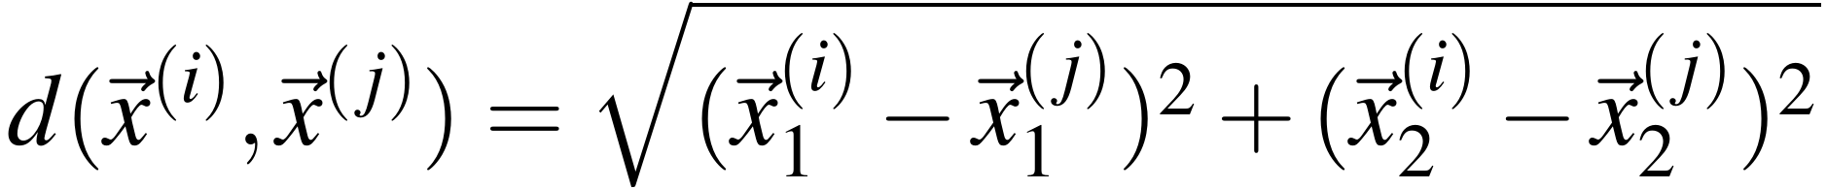
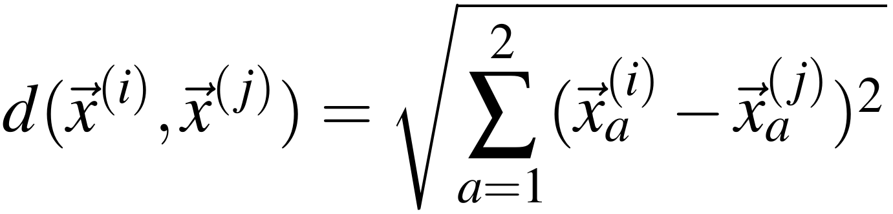
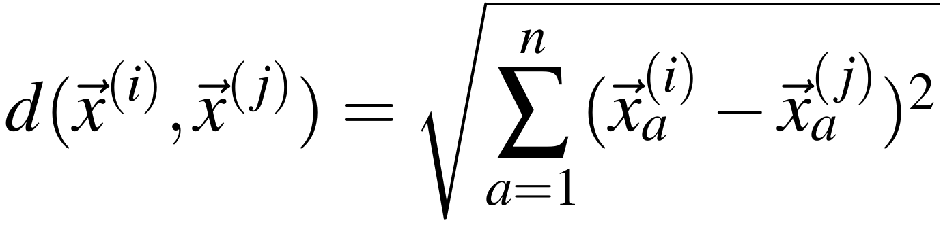
Distance for higher dimensions
For two dimensions, we could rewrite:
as:
So in n dimensions, we can just write:

Slide 3
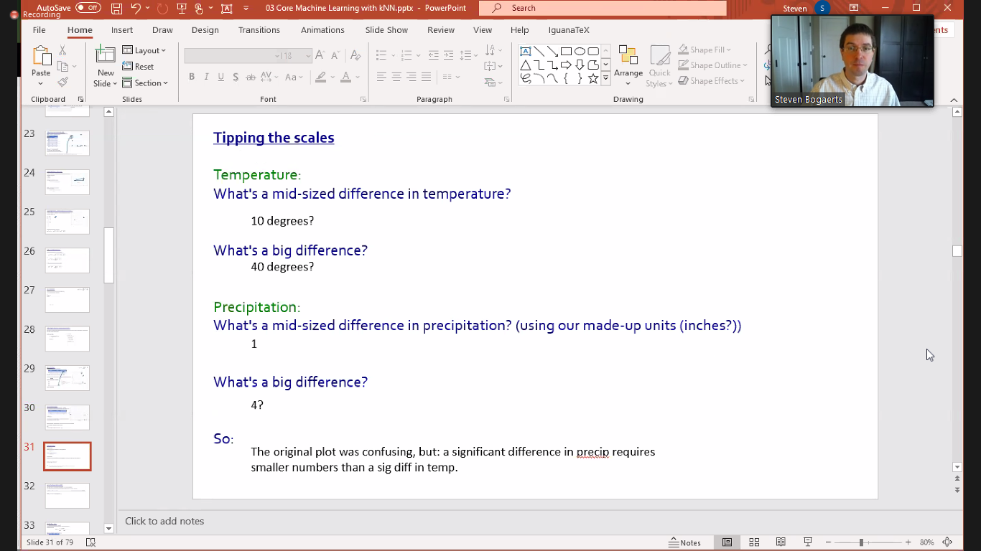
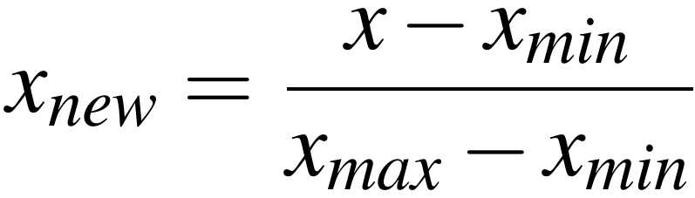
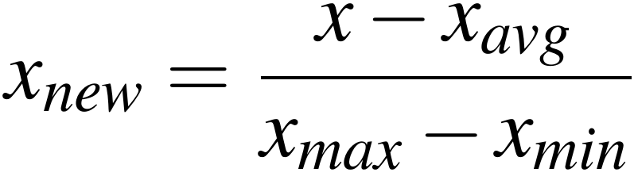
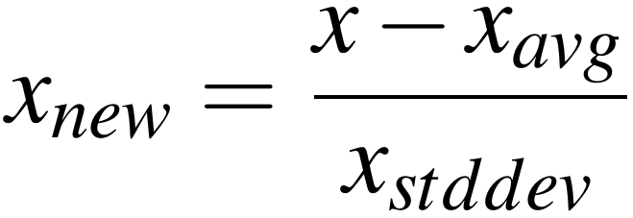
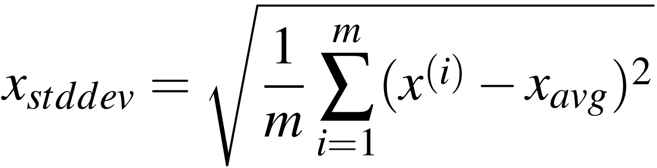
Getting the data on the "same scale"
We could adjust the distance calculation to accommodate this,
but this kind of thing happens frequently in data science, in many contexts.
So instead we'll adjust the __data itself_ to remove this discrepancy in interpretation.
There are two common approaches:
Normalization:
Standardization:
After Regularization, must make sure data is not skewed.

Slide 4
Applying Normalization to [0,1]
normalize:
For every attribute:
find the max and min
For every example:
For every attribute:
normalize according to that attribute's max and min
1NN(p):
normalize p according to max's and min's on which the dataset was normalized
find nearest
return corresponding classification

Slide 5
Or maybe three sets...
Other strategies suggest splitting the dataset into three subsets:
Training set
_validation set__ (aka dev set, development set, hold-out cross-validation set)
Test set
But some people use the phrases "validation set" and "test set" interchangeably.
General process:
Build one or more models with the training set
Tune the models by adjusting algorithm parameters (__hyper parameters__) with the validation set.
On the final tuned model, check its performance with the test set.
What is a hyperparameter? It's a parameter that affects the algorithm itself. For example, in quicksort, the selection technique for a pivot could be considered a hyperparameter. We'll see more about this later, when we study linear regression.
For our purposes, we'll stick with training and test sets, but know that procedures can vary.

Slide 6
Reminder:
leaveOneOutTest(alg, dataset):
for i = 0 to m-1:
testing = x^{(i)}
training = dataset - {x^{(i)}}
model = use alg to fit training
results = use model to predict on testing
Analyze the results
k-fold cross validation
kFoldCV(alg, dataset, k):
for each element in dataset:
randomly assign it to one of the k folds
for i = 0 to k-1:
testing = the i^{th} fold
training = all other folds
model = use alg to fit training
results = use model to predict on testing
Analyze the results (e.g., take an average, look at max and min, etc.)
So leave-one-out testing is just k-fold cross validation where k = _m_.
You're now ready for hw05, hw06, and hw07!

Slide 7
Data Preprocessing: Discretization
Some algorithms require discrete values.
_________________ converts values from a continuous type into a discrete type
Selecting ranges for each discrete value Example: Convert values in [0, 30) to [0, 10) --> 1 [10, 20) --> 2 [20, 30) --> 3
More sophisticated techniques use information theory to determine what size intervals are useful at different parts of the range. Example: Body temperature Below 94 --> 0 (very low) [94, 97) --> 1 (low) [97, 99) --> 2 (normal) [99, 100) --> 3 (mild fever) [100, 102) --> 4 (fever) [102, 105) --> 5 (higher fever) Above 105 (dangerous fever

